Slide 1
HTML5 Forms
Prof Maheswari S,
VIT Chennai

Slide 2
HTML5 Forms
HTML5 forms has many types of inputs

Slide 3
Form Elements and its Types
Text
<input type="text" name="fn" maxlength="10" title="enter your first name" placeholder="enter your first name" required/>
Number
<input type="number"/>
<input type="number" name="points" min="1" max="10" />

Slide 4
Input Types
The range type is displayed as a slider bar.
Range
<input type="range" name="points" min="1" max="10" />

Slide 5
Common Types
Textarea
<textarea rows="8" cols="20"></textarea>
Radio Button or Option
male<input type="radio" name="g" value="m"/>
female<input type="radio" name="g" value="f"/>
Check Box
<input type="checkbox" name="x[]" value="h"/>

Slide 6
Input Types
Password
<input type="password"/>
Email
<input type="email"/>

Slide 7
Date
Date
<input type="date"/>
date - Selects date, month and year
> month - Selects month and year
> week - Selects week and year
> time - Selects time (hour and minute)‏
> datetime - Selects time, date, month and year
> datetime-local - Selects time, date, month and year (local time)‏

Slide 8
Date time
<form action="/action_page.php">
Birthday (date and time):
<input type="datetime-local" name="bdaytime">
</form>

Slide 9
Select list
Option
<select name="country">
<option value="" selected="selected"
disabled="disabled">Select your
country</option>
<option value="1">India</option>
<option value="2">Pakistan</option> </select>

Slide 10
Group Box
Group box labels an entire collection of radio buttons.
A group box - a set of fields indicate a common group.
Syntax:
<fieldset>
<legend align=“top”>legend text</legend>
collection of fields
</fieldset>

Slide 11
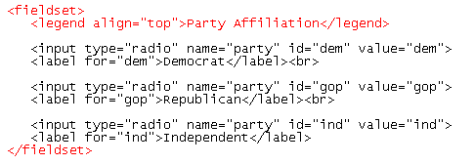

Example – Group Box
start of group box
group box legend
resulting radio buttons and group box

Slide 12
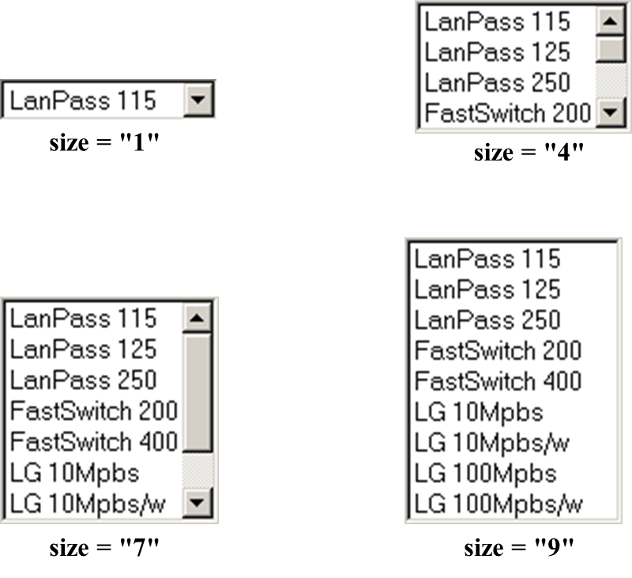
List in different sizes

Slide 13
Dealing with hidden fields
A hidden field - not present in the Web page.
Can be placed anywhere between the pairs of <form> tag.
Syntax
<input type=“hidden” name=“name”
value=“value>
Include a comment describing the purpose of the field.
Notes:
Place all hidden fields in one location to make it easier to read and interpret the HTML code.

Slide 14
Color Picker
Input fields that should contain a color.
Syntax:
Color: <input type="color" name="user_color" />

Slide 15
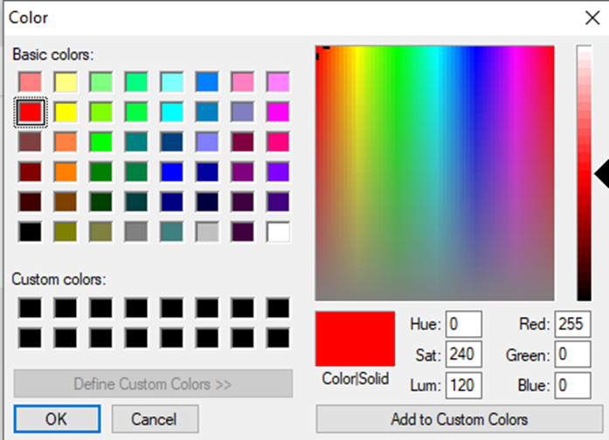
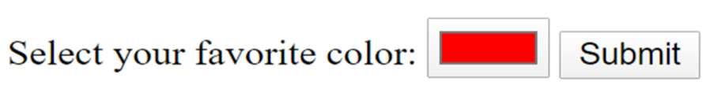
Example
<form>
Select your favorite color:
<input type="color" name="favcolor" value="#ff0000">
<input type="submit">
</form>

Slide 16
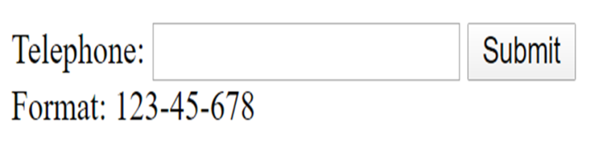
tel
<form>
Telephone: <input type="tel" name="phone"
pattern="[0-9]{3}-[0-9]{2}-[0-9]{3}" required>
<input type="submit">
<span>Format: 123-45-678</span>
</form>

Slide 17
Data list Attribute
The datalist - specifies a list of options for an input field.
It is created with option elements inside the datalist - Same as select
Eg: <datalist id="browsers">
<option value="Internet Explorer">
<option value="Firefox">
</datalist>

Slide 18
Keygen - Security
keygen element is used to provide a secure way to authenticate users.
(keytype:rsa,dsa,ec)
Eg: <keygen name="security" keytype="rsa">

Slide 19
Output Attribute
The output element is used for different types of output, like calculations or script output:
<form oninput="x.value=parseInt(a.value)+parseInt(b.value)">
0<input type="range" id="a" value="50">100
+<input type="number" id="b" value="50">
=<output name="x" for="a b"></output>
</form>

Slide 20
File, Submit & Reset
File
<input type="file"/>
Submit
<input type="submit" value="Save My Data"/>
Reset
<input type="reset" value="Reset Data"/>
Example Program To Check: Ex5_FormElementsanditsInput types.html

Slide 21
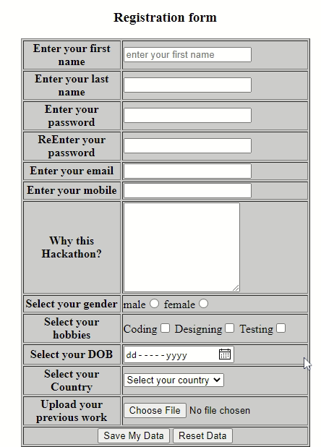
Example - Forms

Slide 22
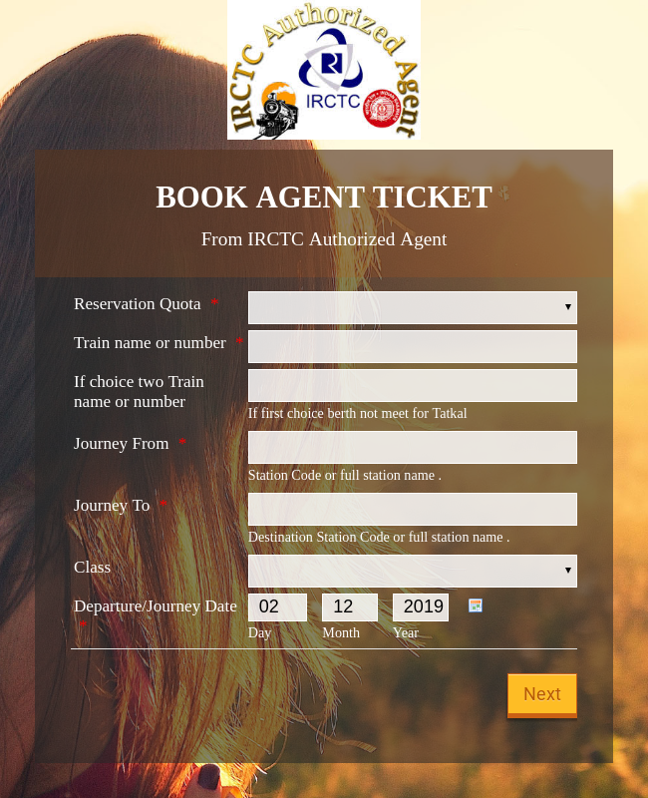
Real Time Website Application

Slide 23
THANK YOU

